Slide 1
Figure 1: Patient selection flow diagram
Eligible Patients
N = 49093
Mortality = 17.5%; Median p50 = 20.71
Excluded
Missing data for key variables: Mortality, p50, Co-morbidity score and SOFA score
N = 13295
Patients after initial screening N = 35798
Mortality = 18.6%; Median p50 = 21.08
Excluded
p50 values inaccurate due to being outside of clinically feasible range of 10 to 100
N = 11950
Patients included in final analysis
N = 23848
Mortality = 18.8%; Median p50 = 24.69

Slide 2
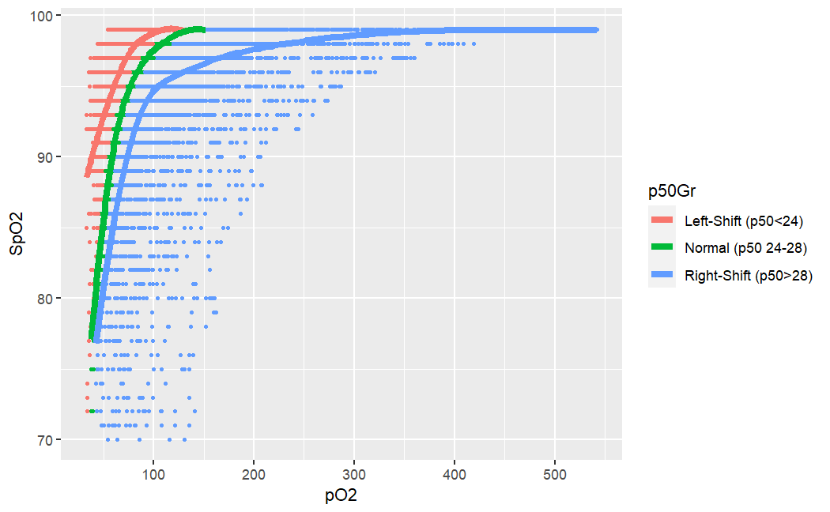
Oxyhemoglobin Dissociation Curve

Slide 3
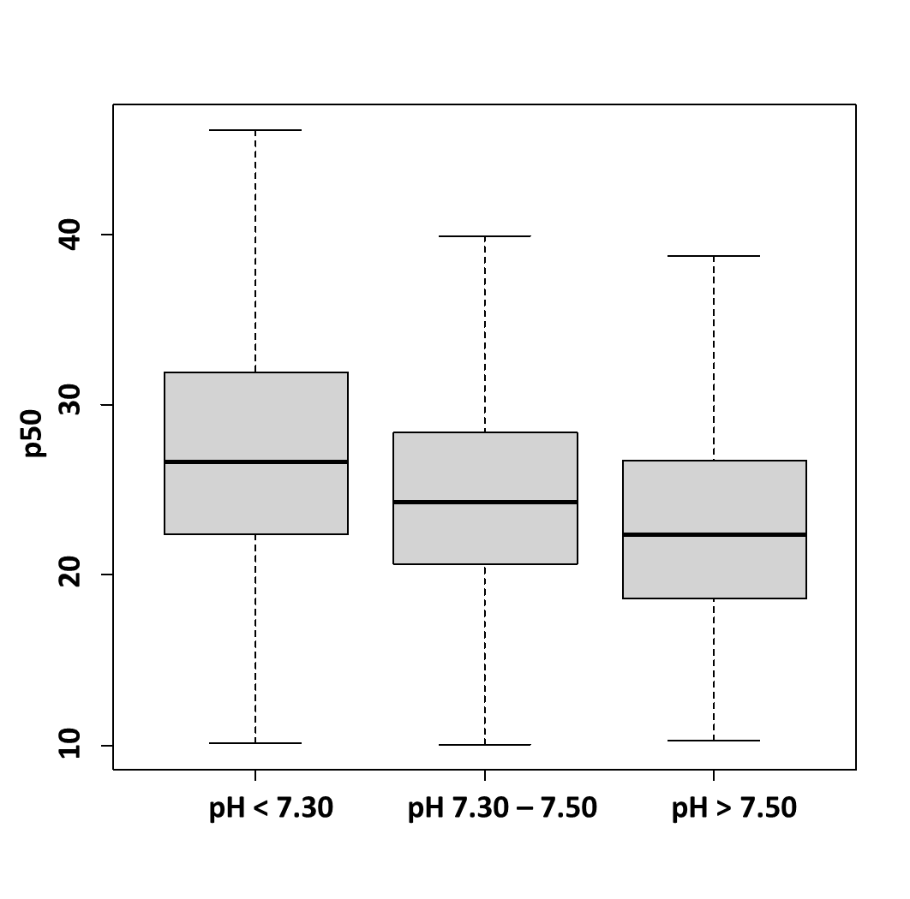
 | p50 Mean ± SD | p-value
pH < 7.30 | 29 ± 13 | < 0.001
pH 7.30 – 7.50 | 26 ± 10
pH > 7.50 | 25 ± 11

Slide 4
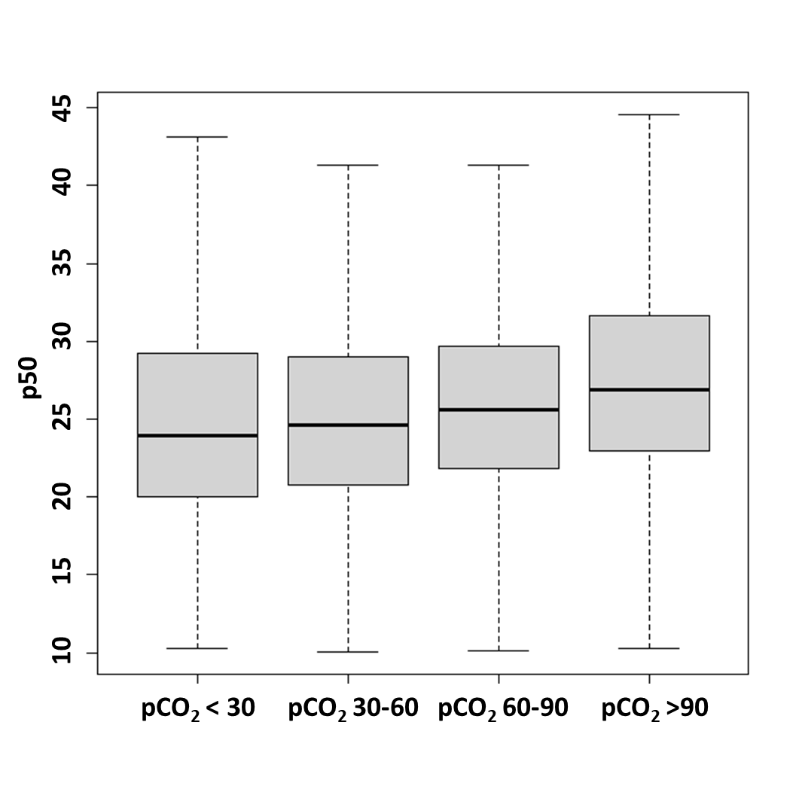
 | p50 Mean ± SD | p-value
pCO₂ < 30 | 27 ± 13 | < 0.011
pCO₂ 30 – 60 | 27 ± 11
pCO₂ 60 – 90 | 27 ± 10
pCO₂ > 90 | 29 ± 13

Slide 5
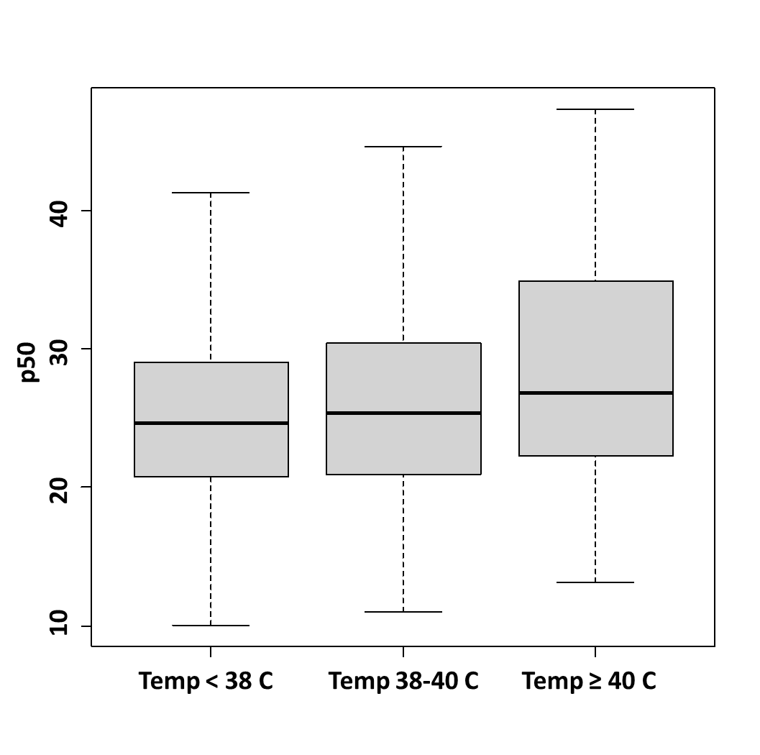
 | p50 Mean ± SD | p-value
Temp < 38 C | 29 ± 13 | < 0.001
Temp 38–40 C | 26 ± 10
Temp ≥ 40 C | 25 ± 11

Slide 6
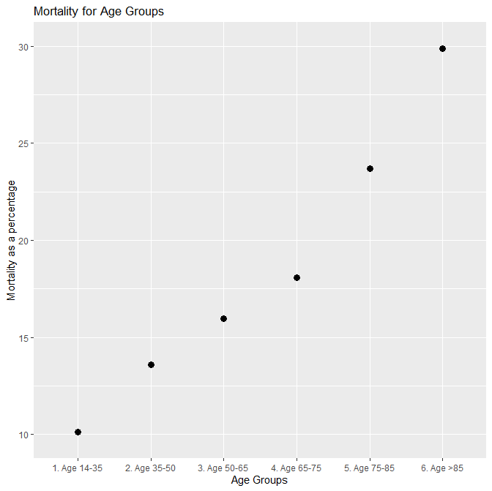

Slide 7
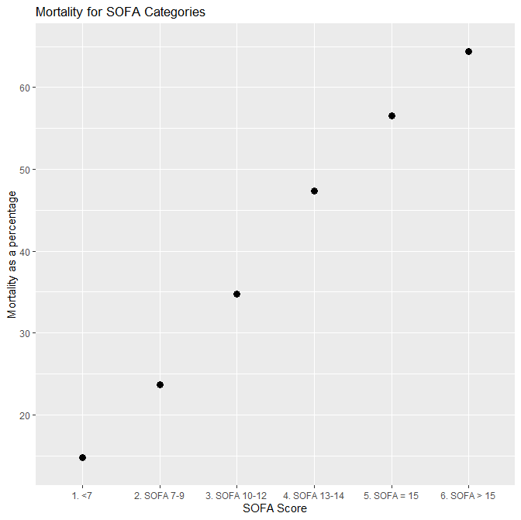
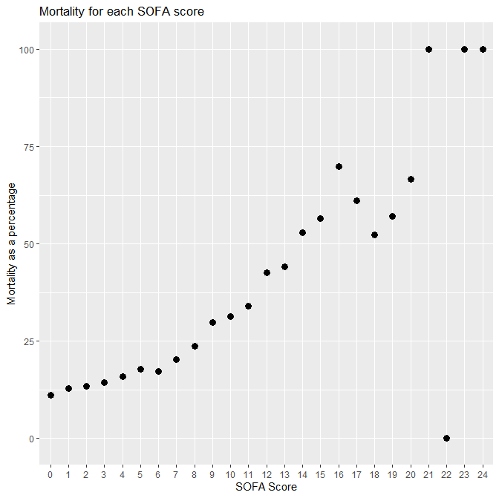

Slide 8
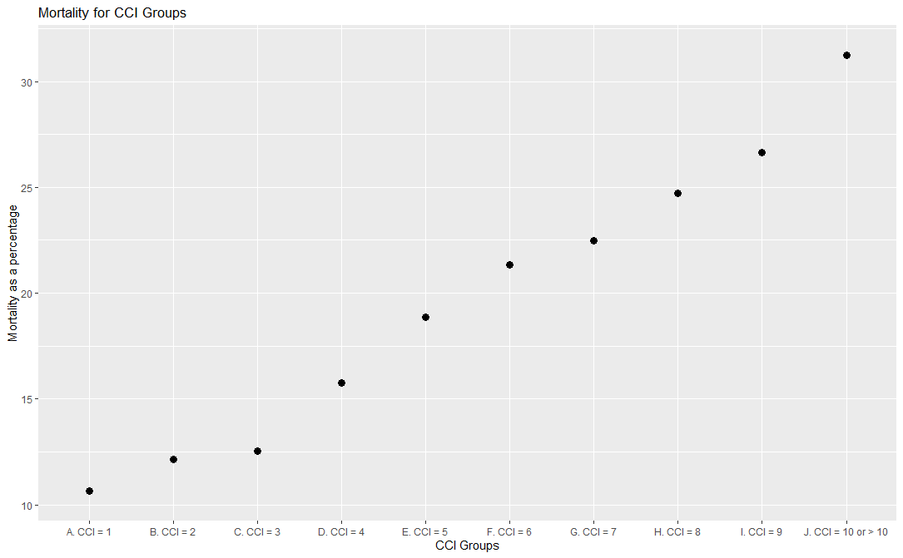

Slide 9
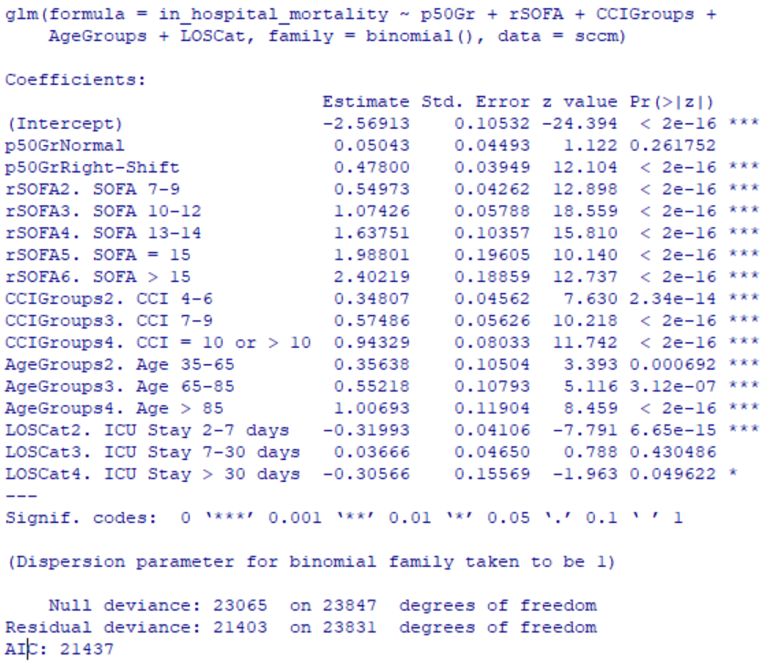

Slide 10
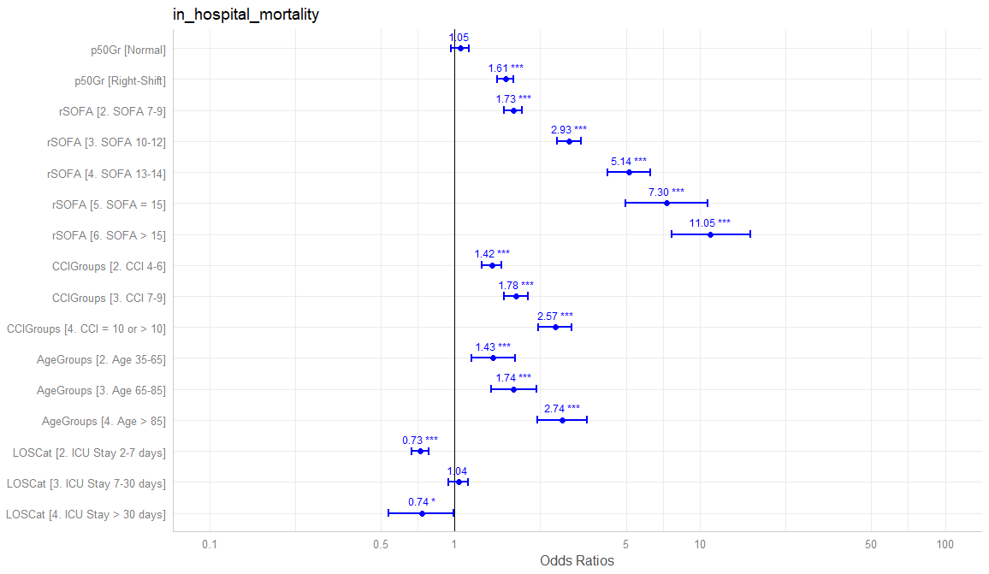

Slide 11
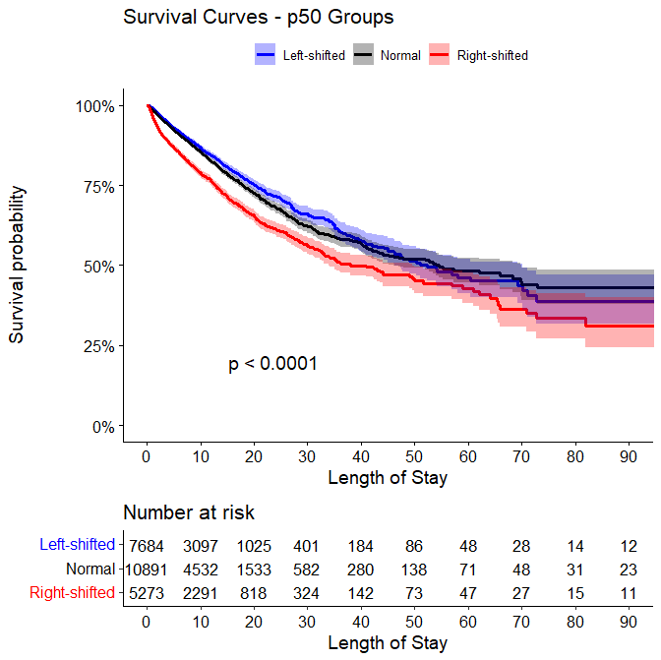

Slide 12
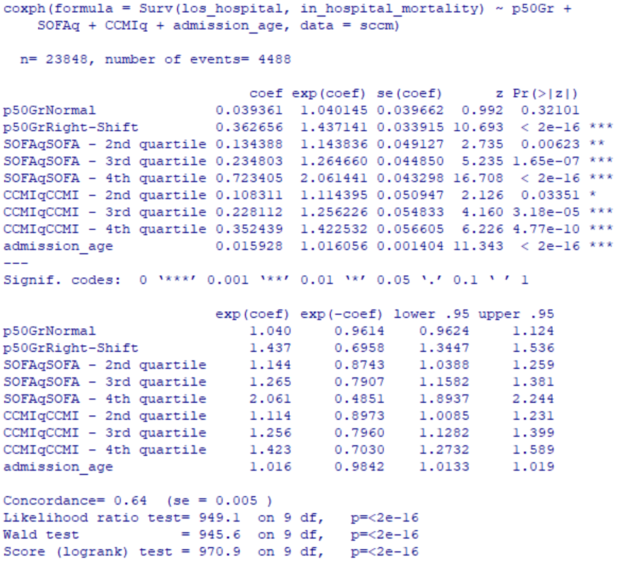

Slide 13
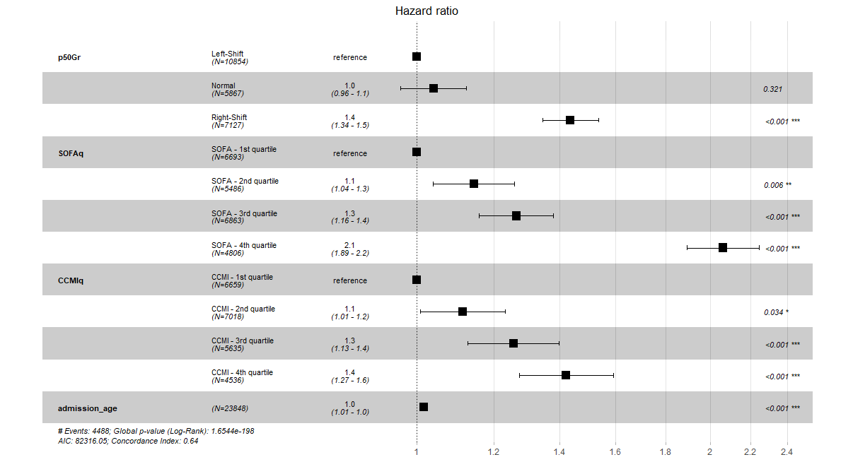

Slide 14
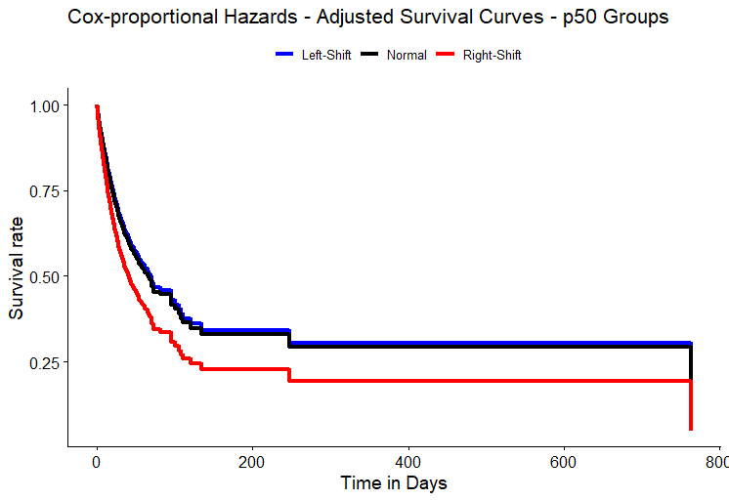

Slide 15
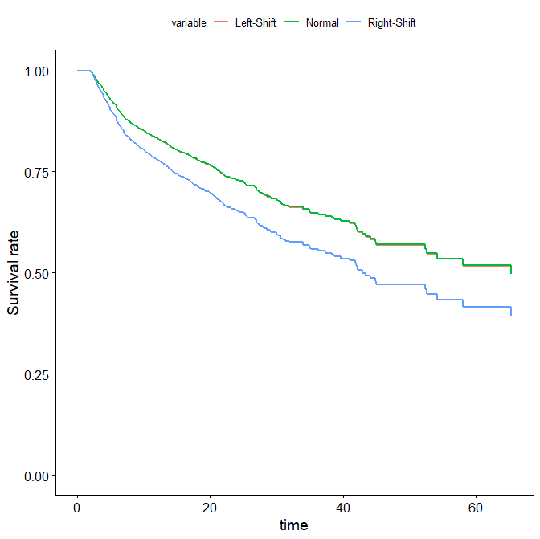
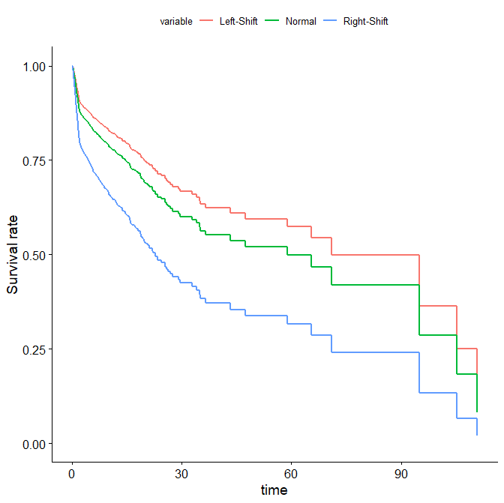
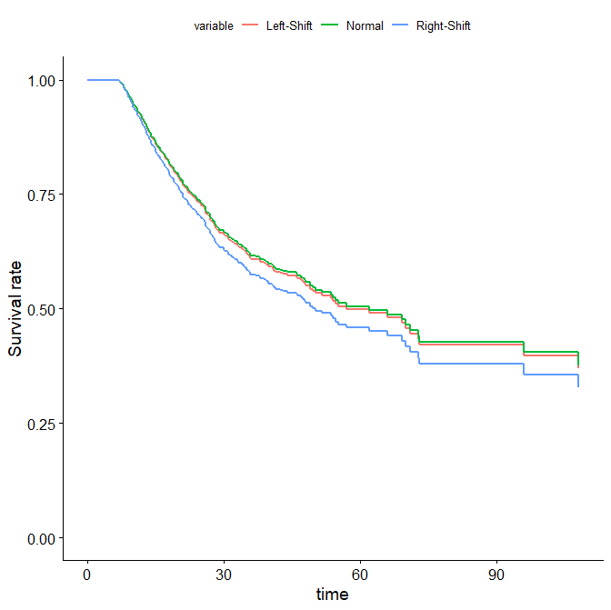
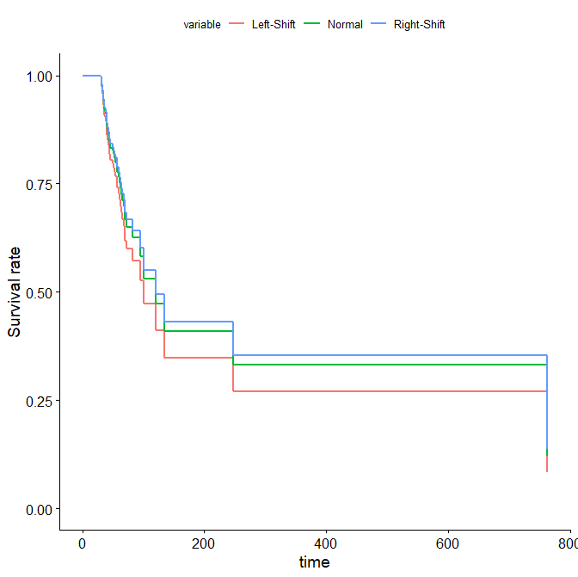

Slide 16
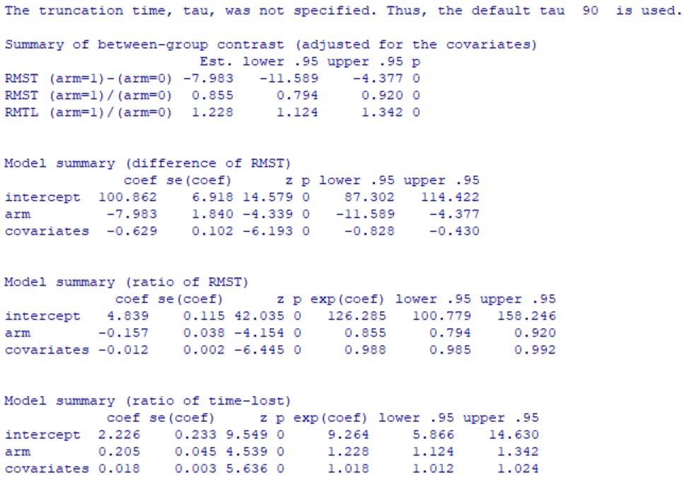

Slide 17
